Slide 1


A Mathematical Introduction to Data Science Lecture 1: PCA/MDS and High Dimensionality
Yuan Yao
Peking University
2015.5.5.

Slide 2
Short Course Information
Instructor: 姚远
Email: yuany@math.pku.edu.cn
PKU-Course Website: http://www.math.pku.edu.cn/teachers/yaoy/Fall2014
Ebanshu public lectures: http://www.ebanshu.com/
Time & Venue:
Lecture 1, 2, 3: May 5, 6, 7; 3-5pm, 107 Hung-Ching Bldg, NCU

Slide 3
Main Content
Lecture 1: Sample mean and Covariance (PCA/MDS): Fisher’s Principle of Maximum Likelihood Estimate, yet things might go wrong --
Stein’s phenomenon and shrinkage
Random matrix theory and failure of PCA
Lecture 2: Beyond PCA/MDS
Random projections and compressed sensing
Semidefinite Programming (SDP) extensions of PCA/MDS:
Robust PCA
Sparse PCA
MDS with uncertainty (Sensor Network Localization)
Lecture 3: Geometric and Topological structures of data
Nonlinear manifold learning: ISOMAP/LLE etc.
From graphs to simplicial complexes: persistent homology, exterior calculus, cohomology, etc.

Slide 4
Data Representation: Geometric Embedding
Data Science is the study of generalizable extraction of Knowledge from data [Wikipedia]
A fundamental problem is data representation
“unstructured data” (speech, text, image, video, etc.) => Euclidean space
a.k.a. “feature learning” (e.g. kernel method, deep learning)
Sparsity structure (information complexity) lies in the core of high dimensional data analysis, e.g.
Low dimensional vector spaces
Low rank matrices, tensors, etc.

Slide 5
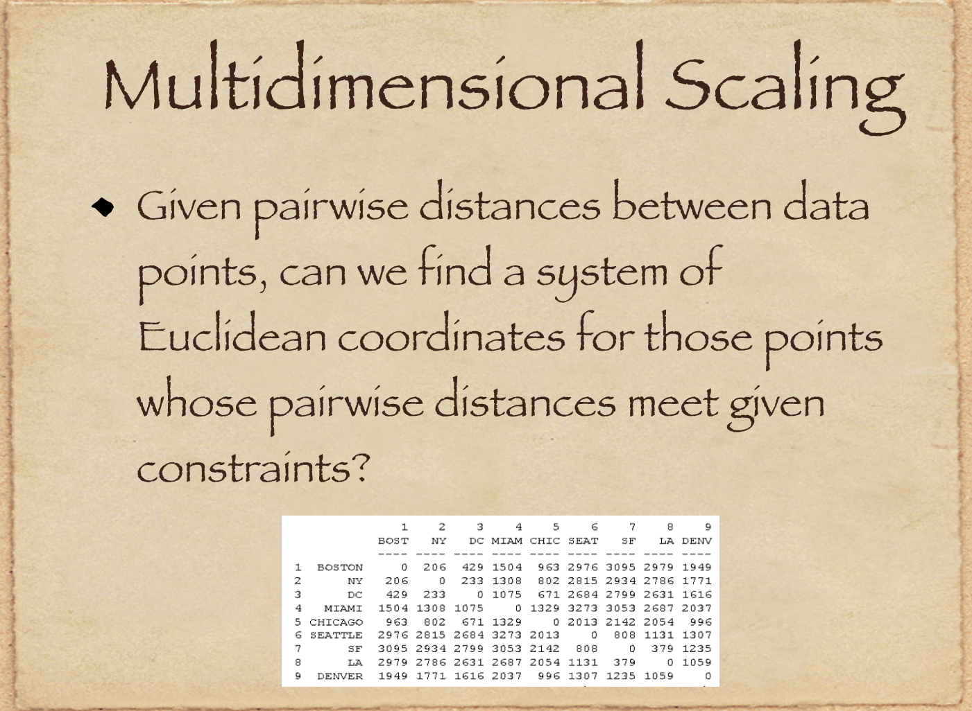

Slide 6
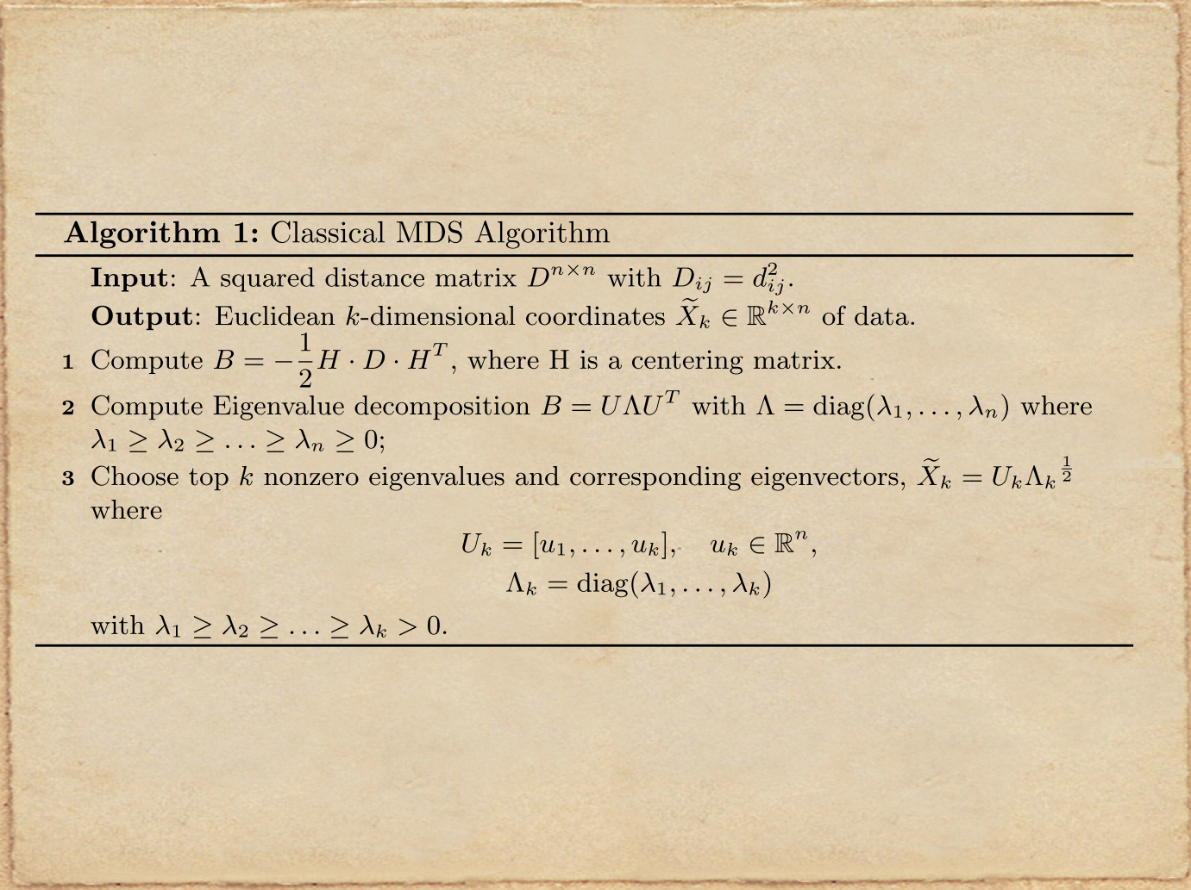

Slide 7
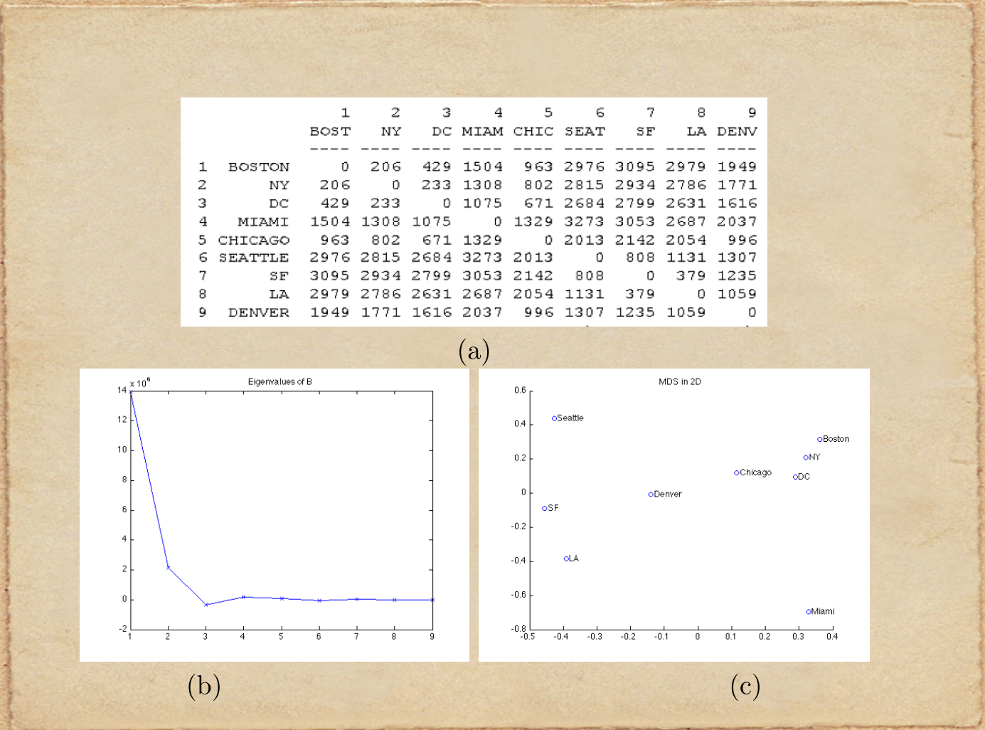

Slide 8
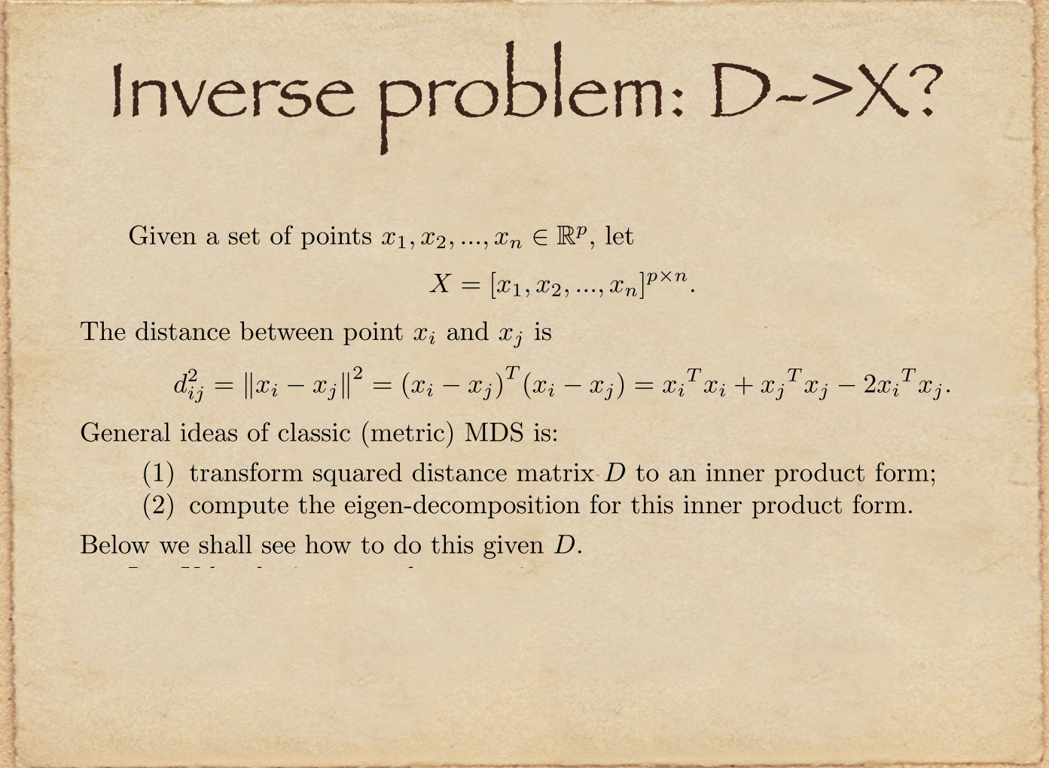

Slide 9
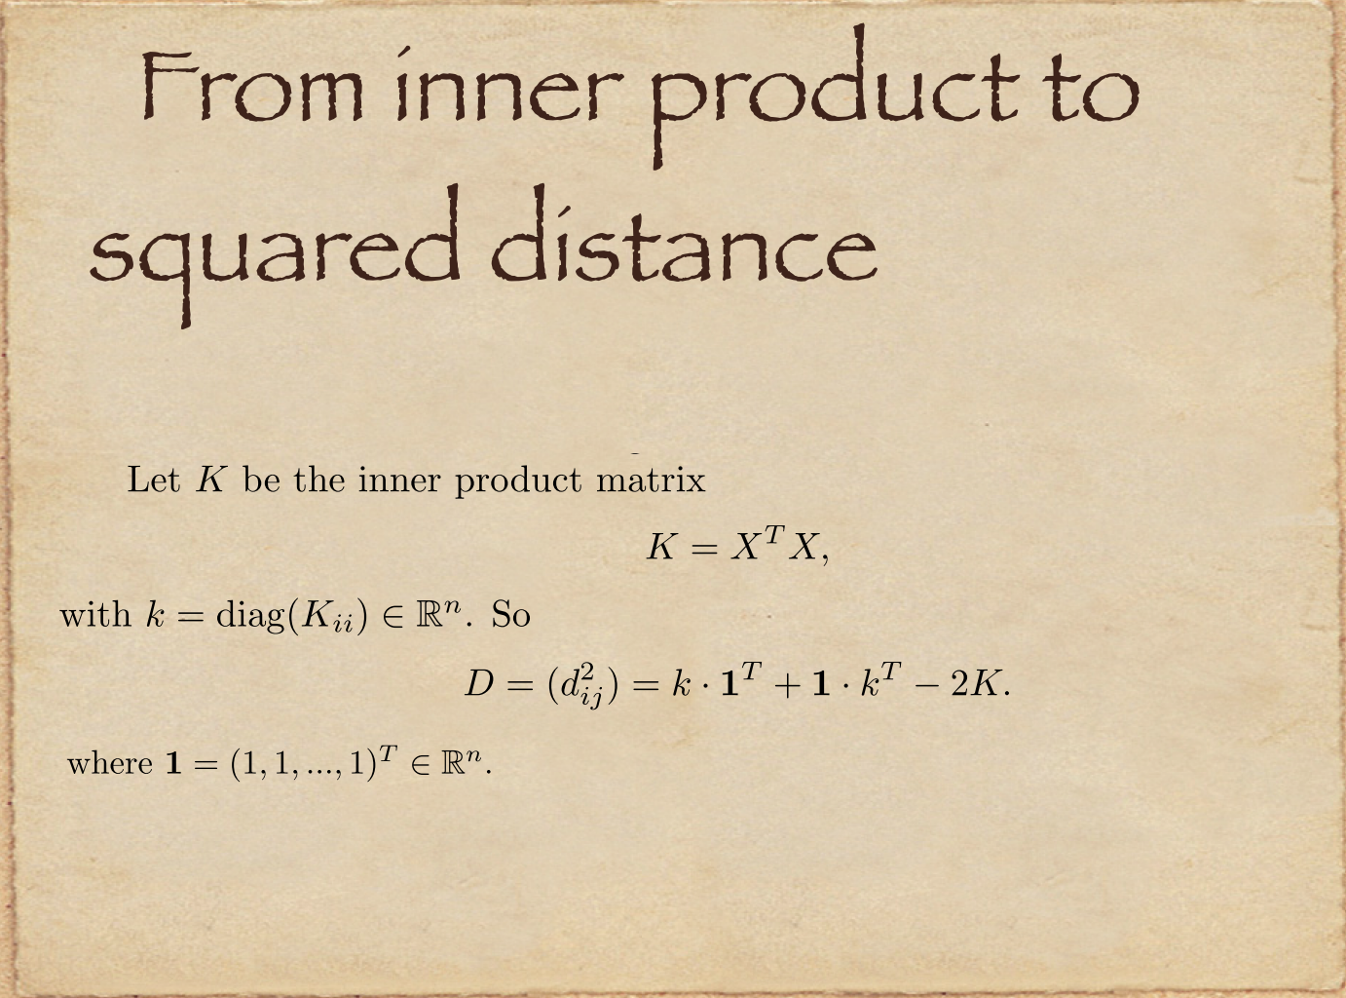

Slide 10
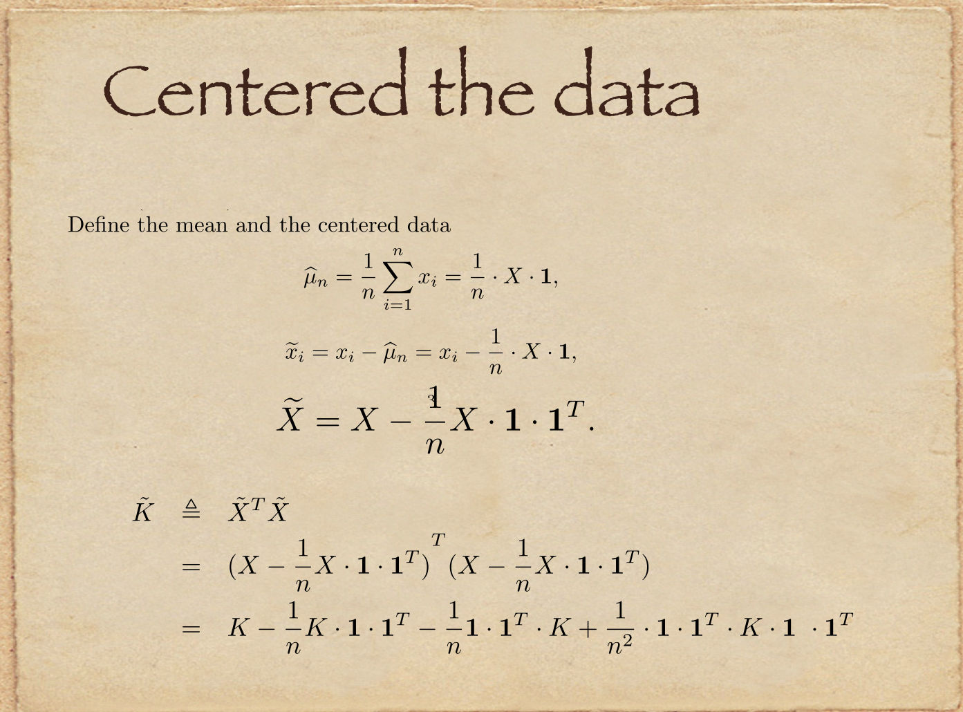

Slide 11
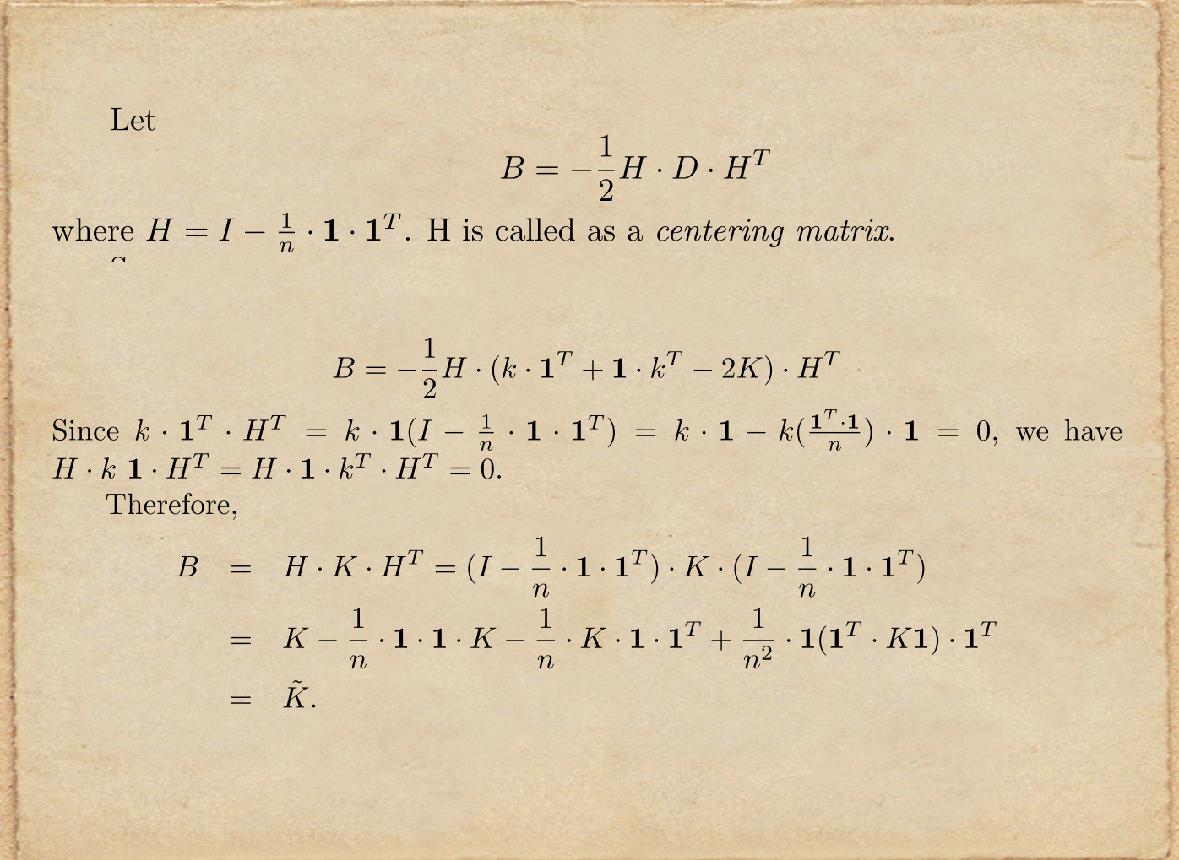

Slide 12
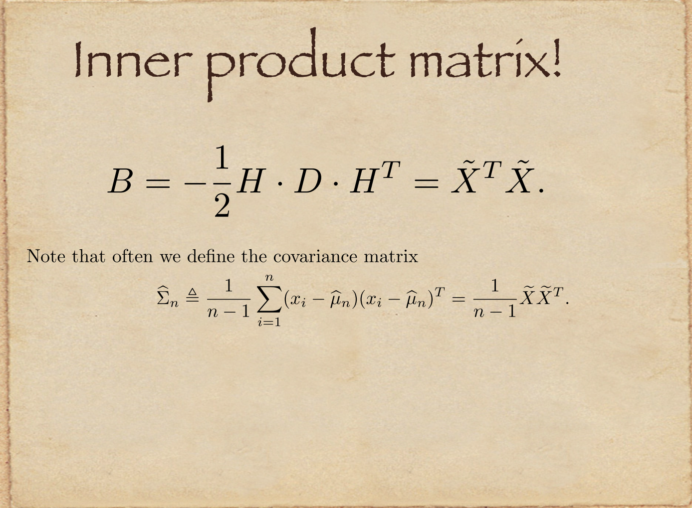

Slide 13
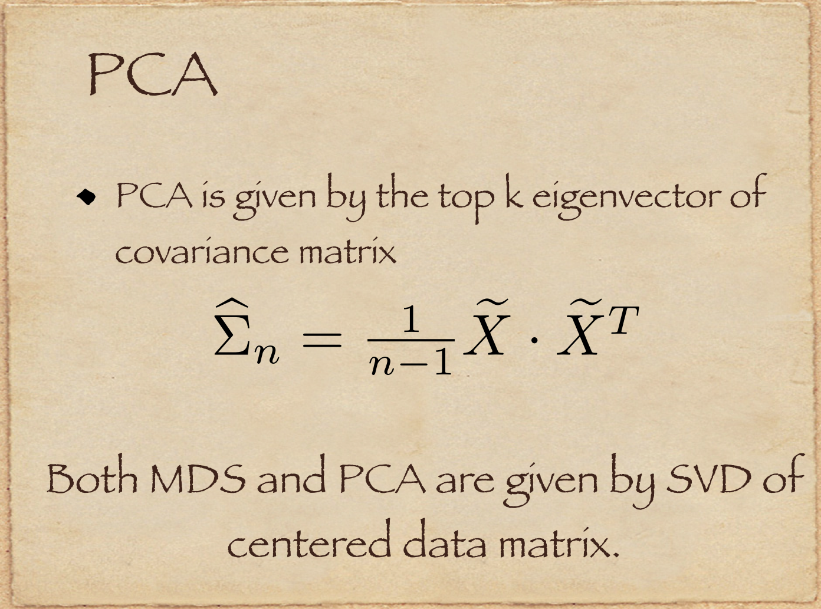

Slide 14
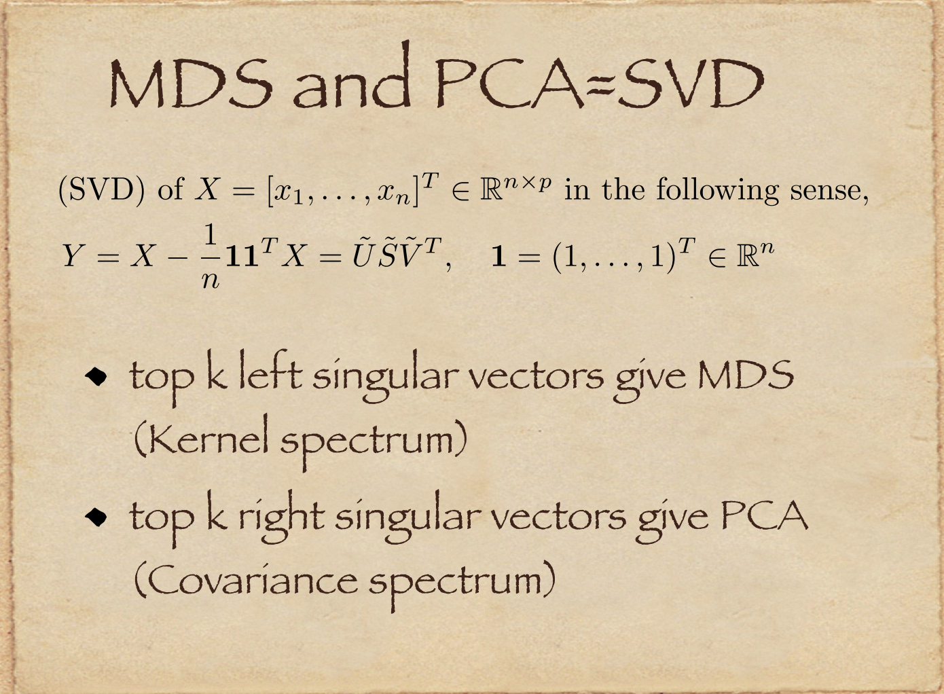

Slide 15
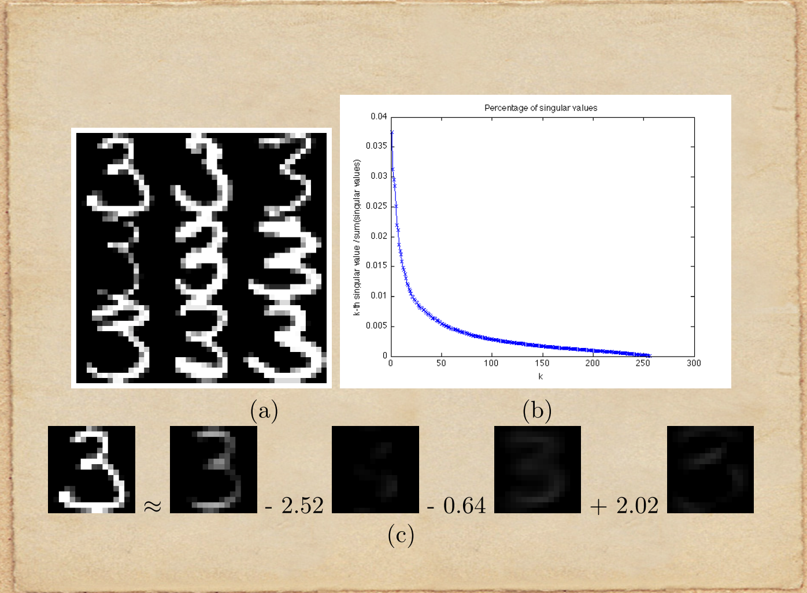

Slide 16
Any principles underlying these tricks?
Dimensionality reduction formed in geometry and optimization
Statistics: Fisher’s maximal likelihood estimate

Slide 17
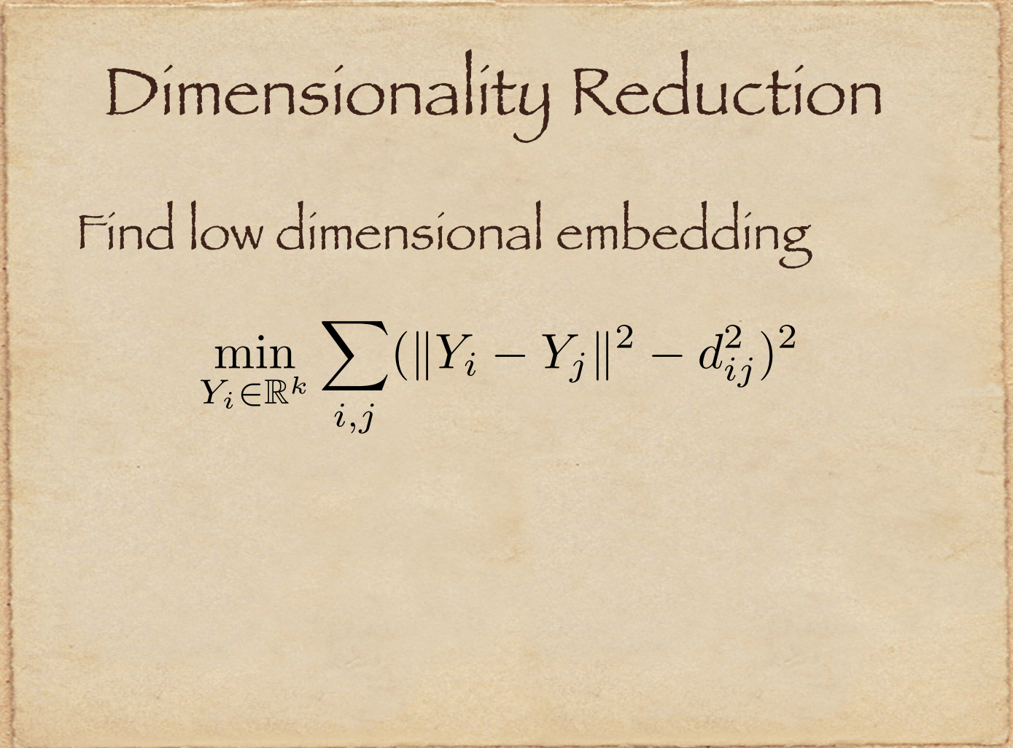

Slide 18
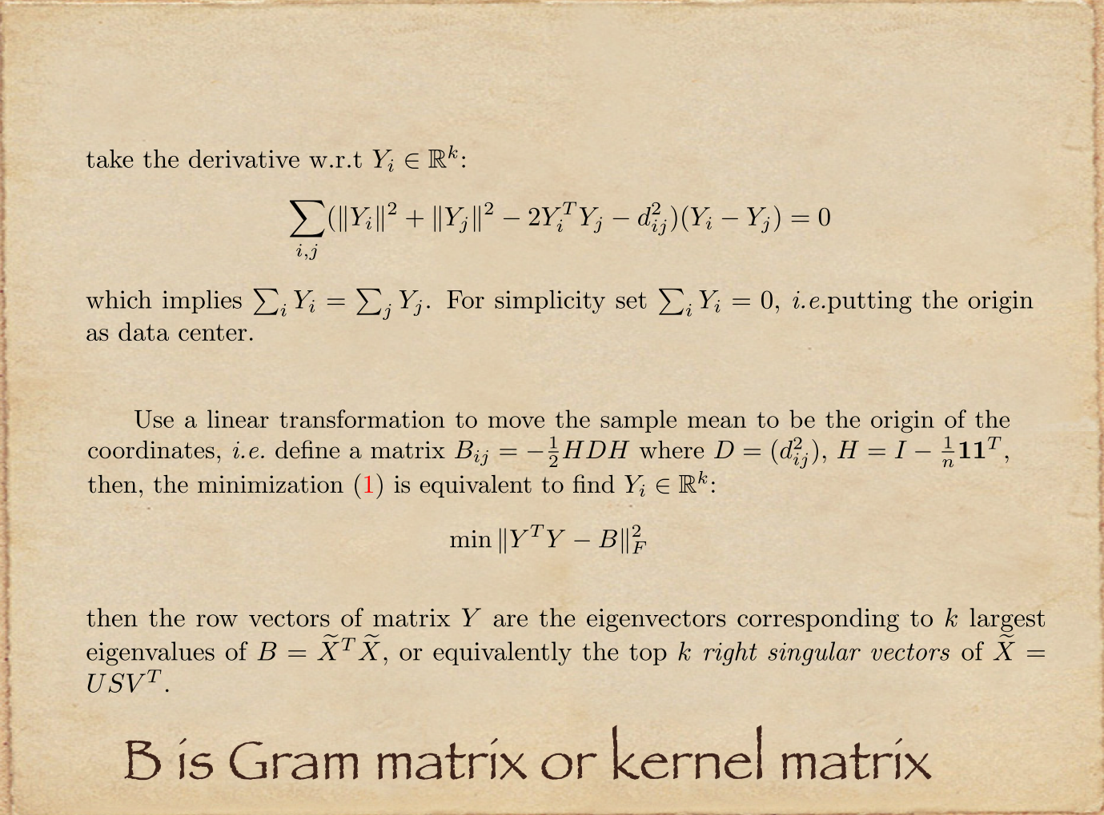

Slide 19
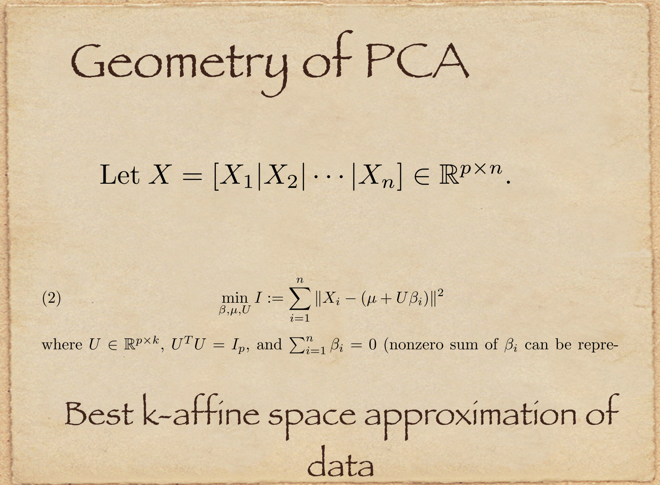

Slide 20
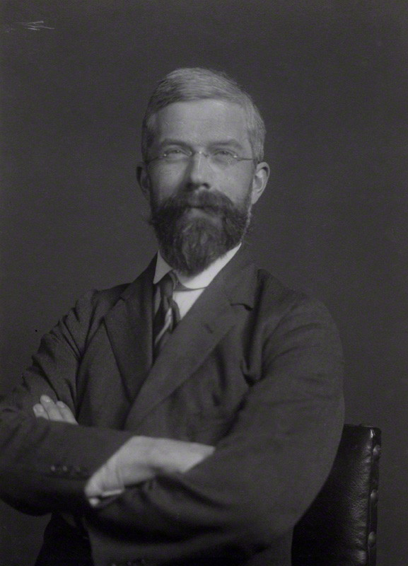
Fisher’s Principle of Maximum Likelihood Estimate
Ronald Fisher: On the Mathematical Foundations of Theoretical Statistics, 1921

Slide 21
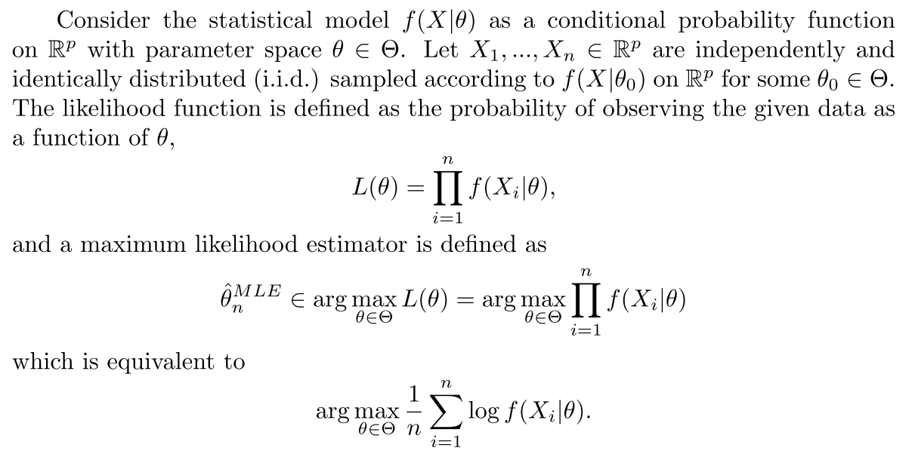

Slide 22
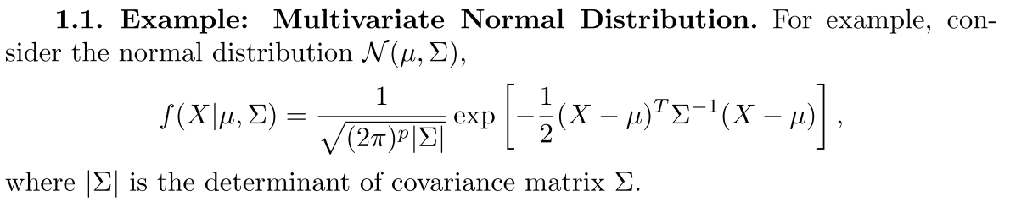
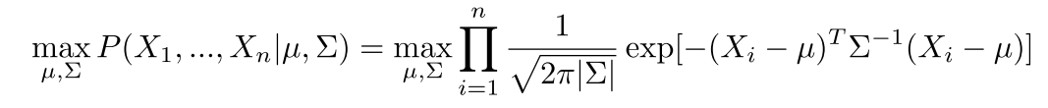
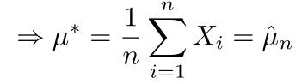
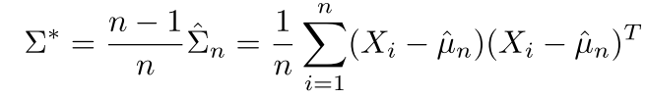
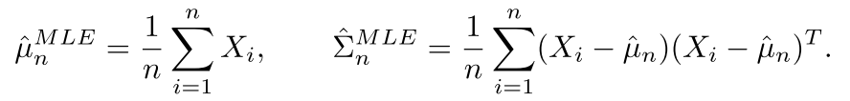

Slide 23
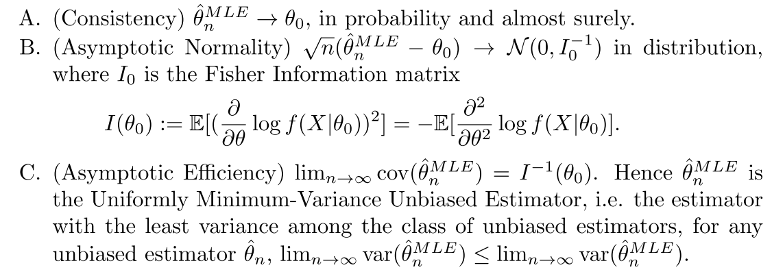
Asymptotic properties of MLE
Yet with a finite sample, MLE might not be good!

Slide 24
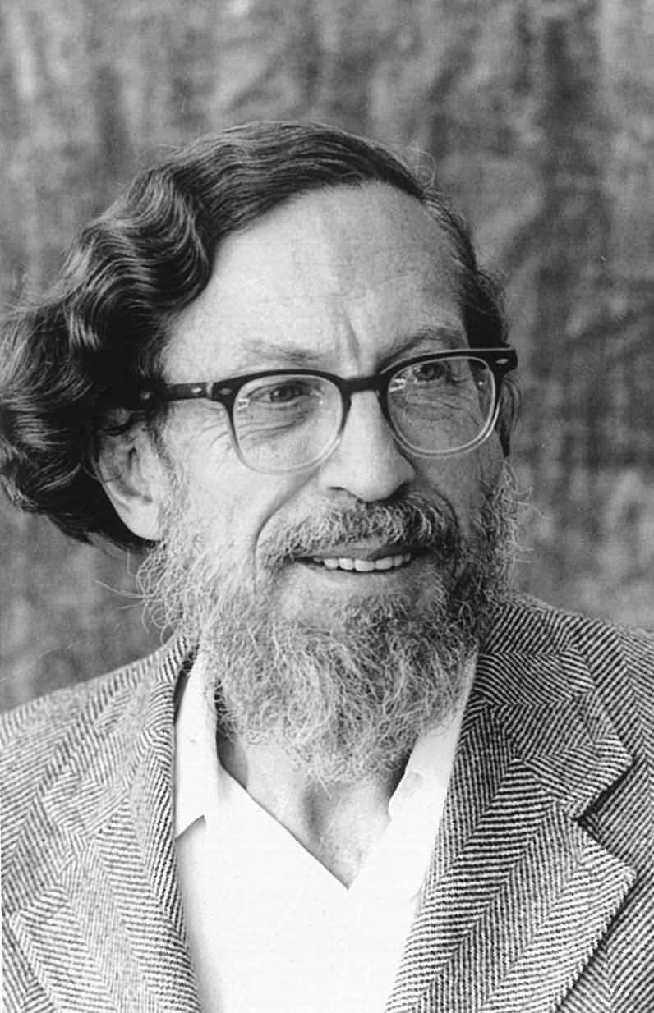

Two curses of high dimensionality for MLE
Stein’s Phenomenon: sample mean may have more ‘risks’ (mean square error) than some biased estimators (e.g. shrinkage)
Random Matrix Theory: PCA via sample covariance might tell you nothing more than noise

Slide 25
Stein’s Phenomenon
Risk of Estimators and Inadmissibility
Linear Estimators (MLE is a special case)
James-Stein Estimators
Soft- and Hard-Thresholding Estimators

Slide 26
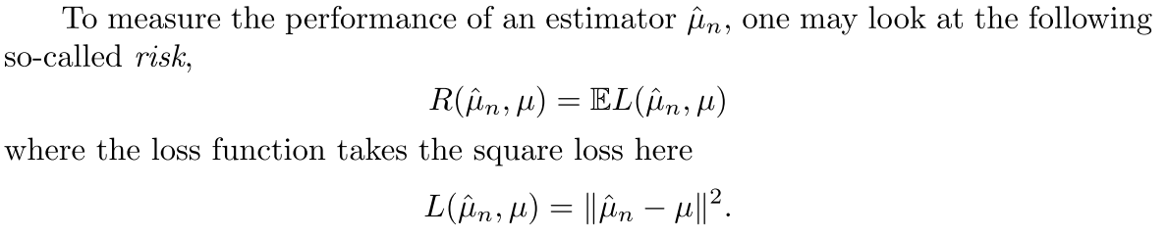
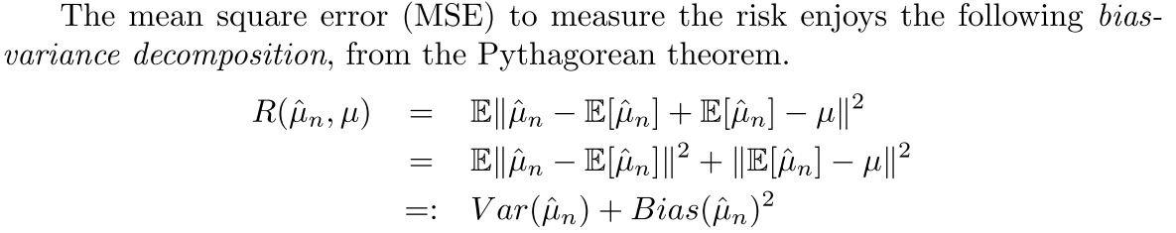
Risk and Bias-Variance Decomposition

Slide 27
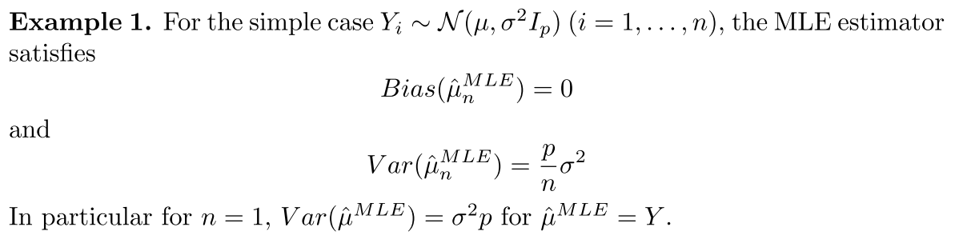

Slide 28
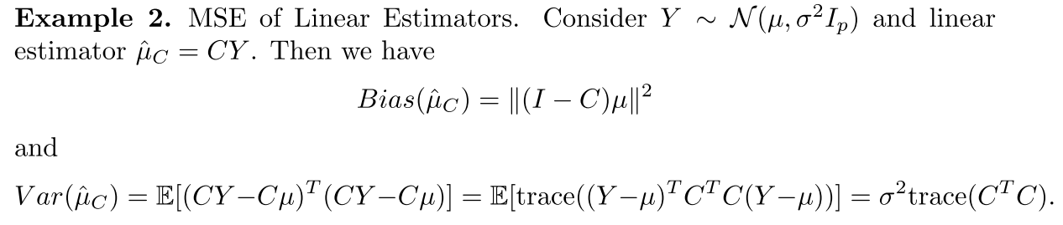
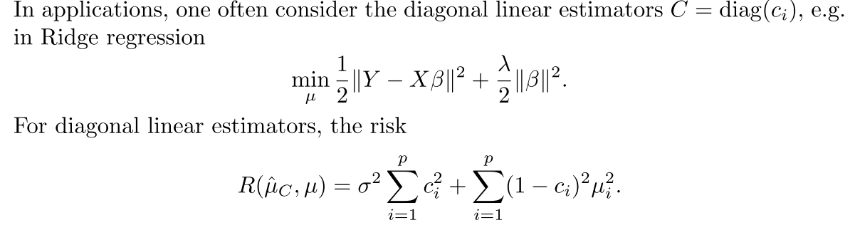
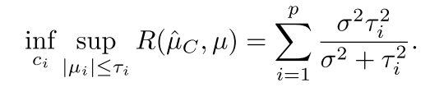

Slide 29
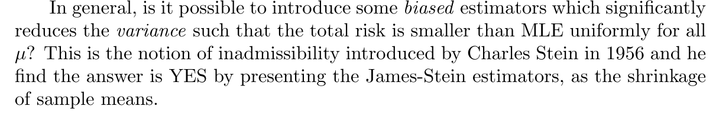
MLE (sample mean + covariance) might not be the best!

Slide 30
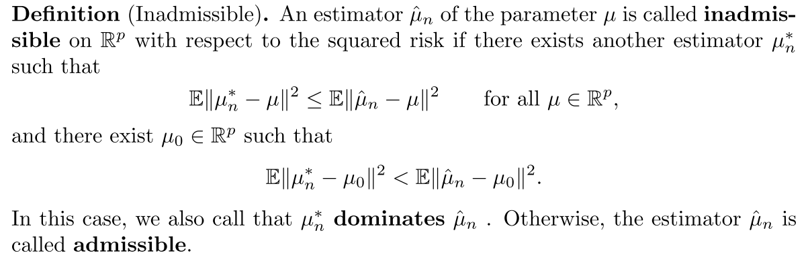

Slide 31
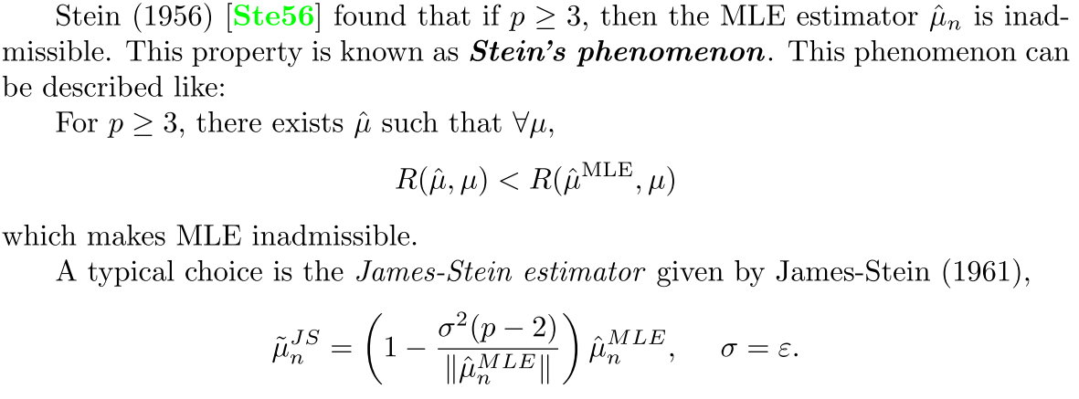
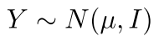
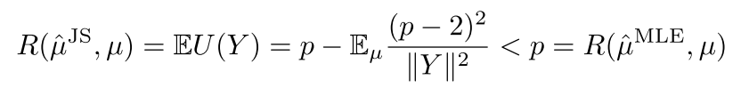
E.g. assume the sample has unit-variance

Slide 32
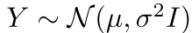
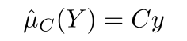
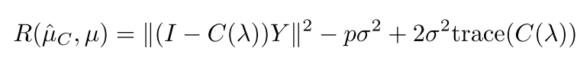
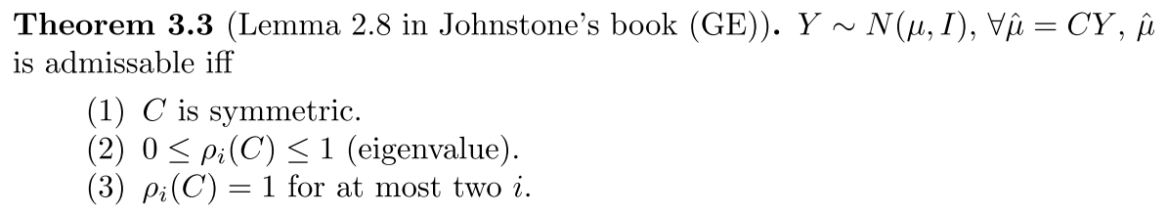
Linear Estimators are mostly inadmissible

Slide 33
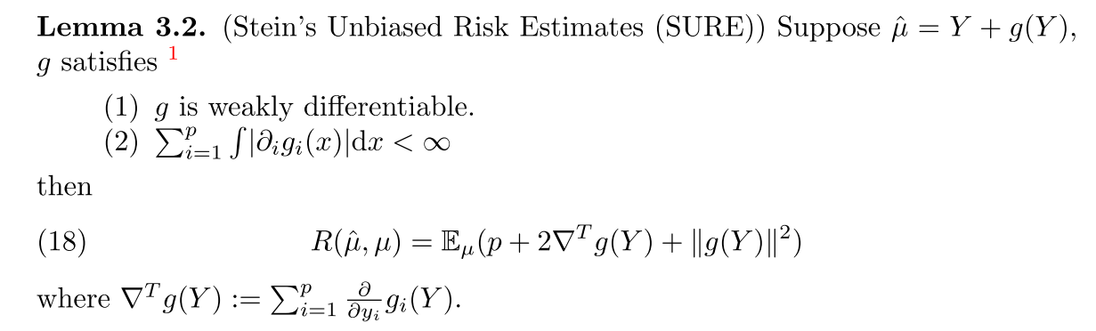
Stein’s Unbiased Risk Estimate (SURE)
W.L.G. assume unit variance,

Slide 34
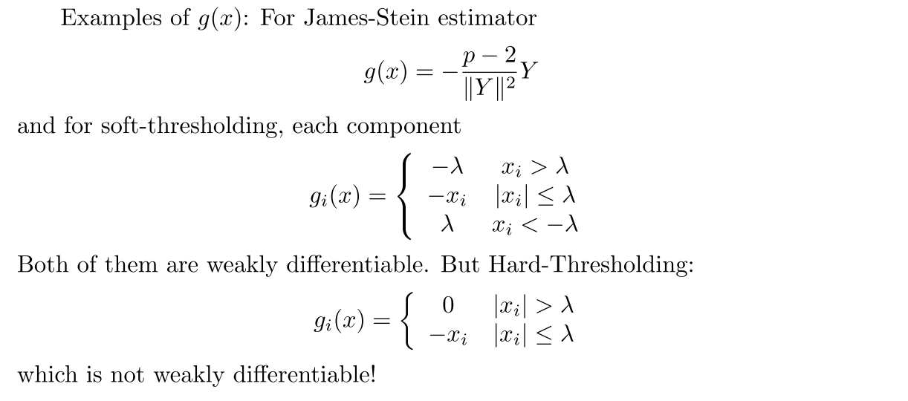
Note that soft-thresholding solves LASSO while hard-thresholding solves L0-penalization (nonconvex)

Slide 35
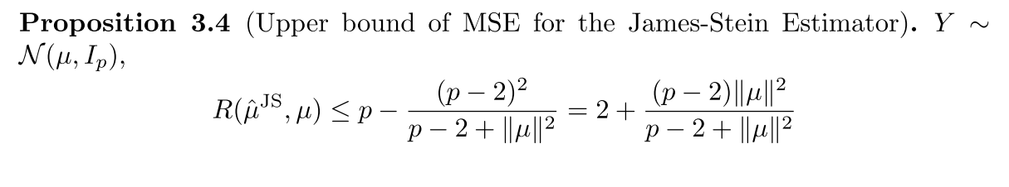
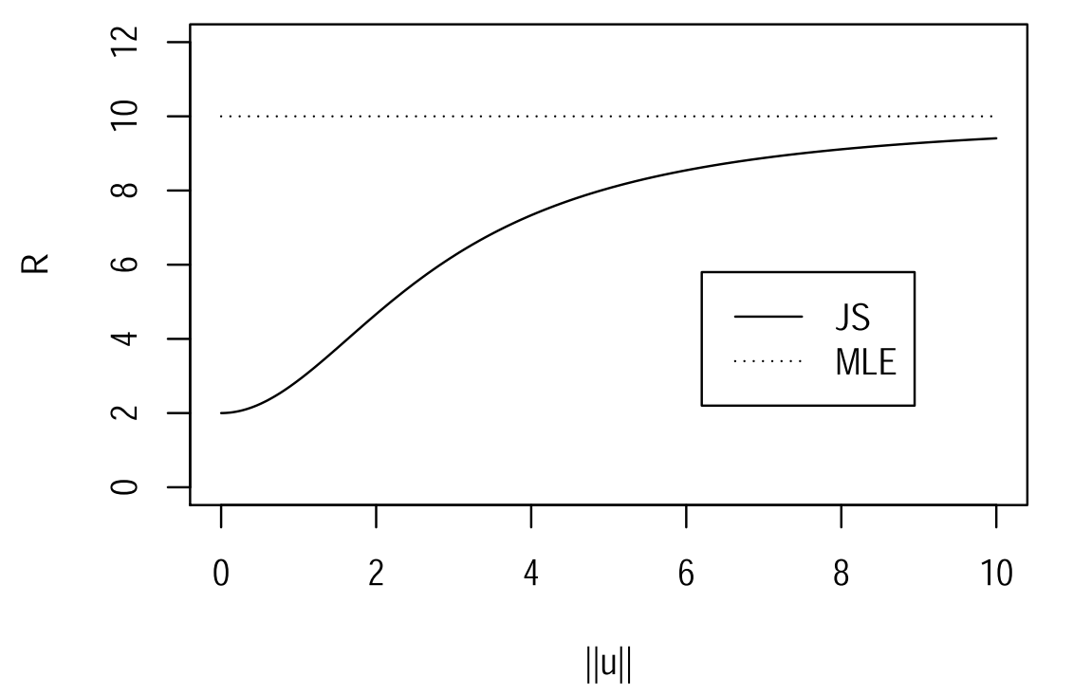
Risk of James-Stein Estimator

Slide 36
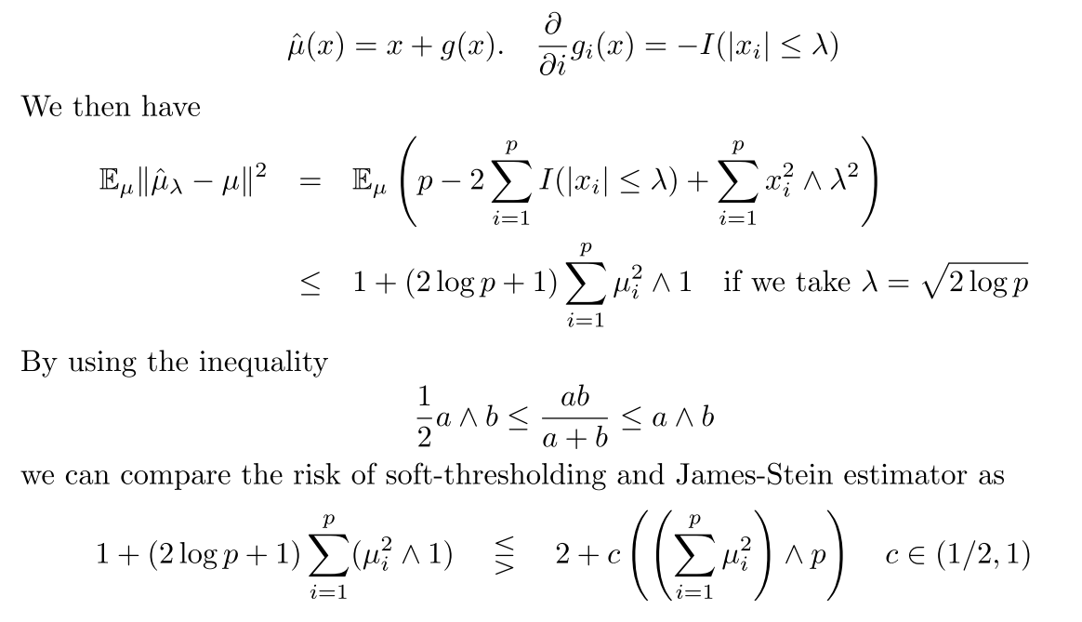
Risk of Soft-Thresholding
Soft is better than JS for sparse and large signal, O(k log p) < O(p)

Slide 37
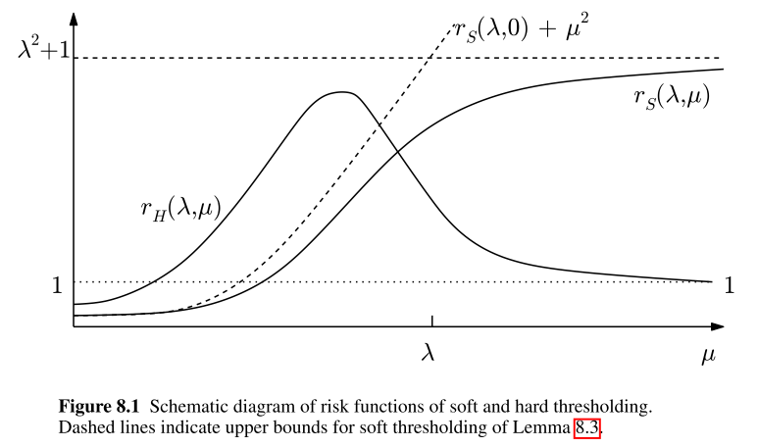
*Risk Comparison Between Soft- and Hard-Thresholding [Johnstone, GE]

Slide 38
Random Matrix Theory and PCA
PCA undergoes a phase transition:
Strong signal, PCA tells you the signal
Weak signal, PCA tells you nothing more than noise

Slide 39
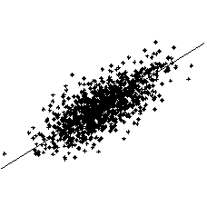
Principal Component Analysis (PCA)
Principal Component Analysis (PCA)
Eigen-decomposition of
for fixed p and n->∞
One Dimensional Manifold

Slide 40
PCA may go wrong if p ≥ n
For p/n = γ >0, assume p-dimensional X_{i}
where θ_{ν} are orthonormal, then PCA is inconsistent by Random Matrix Theory
Phase transition:
Below the threshold, estimation is orthogonal to the truth
Above the threshold, the angle decreases as eigenvalue grows, but always biased
Johnstone (2006) High Dimensional Statistical Inference and Random Matrices,
arxiv.org/abs/math/0611589v1

Slide 41
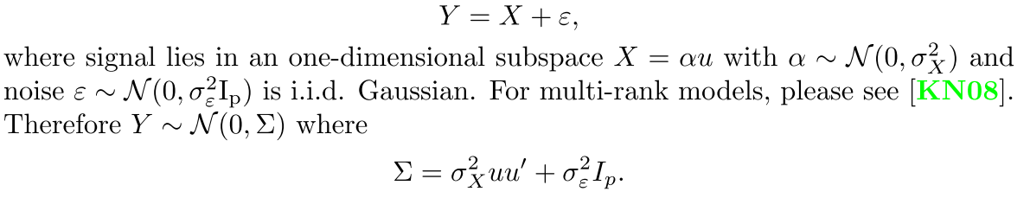
E.g. Rank-1 model
Can we recover signal direction (u) by PCA?

Slide 42
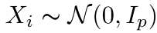
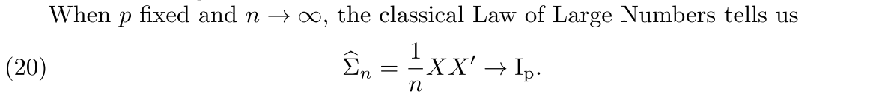
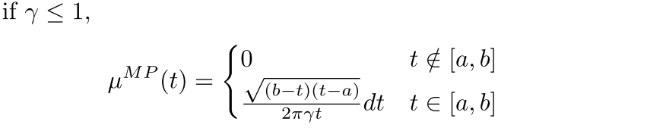
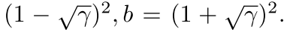

Noise has a spectrum: Marcenko-Pastur Distribution
A.
B.

Slide 43



A Phase Transition in PCA

Slide 44

Sparsity plays a central role

Slide 45
Sparsity (Information Complexity) triggers a dawn of the Science for High Dimensional Data Analysis
When p>>n, PCA may work with additional requirements
Σ is sparse or banded (Toeplitz)
Σ is low rank
Σ⁻¹ is sparse or structured
Various extensions…
Geometry and topology begin to enter this Odyssey: data concentrate on
low-dimensional subspaces, manifolds …

